Slide 1


19CSE301 COMPUTER NETWORKS
3-0-3 4

Slide 2
APPLICATION LAYER
Peer to Peer Applications

Slide 3

































Pure P2P architecture
no always-on server
arbitrary end systems directly communicate
pairs of intermittently connected hosts, called peers, communicate directly with each other.
examples:
file distribution (BitTorrent)
Streaming (KanKan)
VoIP (Skype)
Application Layer
2-24

Slide 4
P2P File distribution
We begin our foray into P2P by considering a very natural application, namely,
distributing a large file from a single server to a large number of hosts (called peers).
In client-server file distribution, the server must send a copy of the file to each of the peers—placing an enormous burden on the server and consuming a large amount of server bandwidth
In P2P file distribution, each peer can redistribute any portion of the file it has received to any other peers, thereby assisting the server in the distribution process.

Slide 5










File distribution: client-server vs P2P
Question: how much time to distribute file (size F) from one server to
N peers?
peer upload/download capacity is limited resource
u_{s}: server upload capacity
u₁
d_{i}: peer i download
capacity
file, size F
u_{s}
d
1
u₂
d₂
server
d_{i}
u_{i}
u_{N}
d_{N}
network (with abundant
bandwidth)
u_{i}: peer i upload capacity
Application Layer
2-26

Slide 6
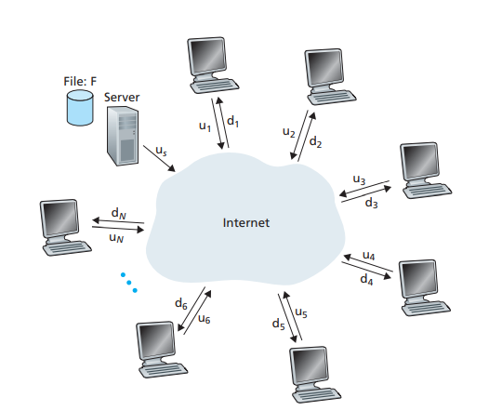
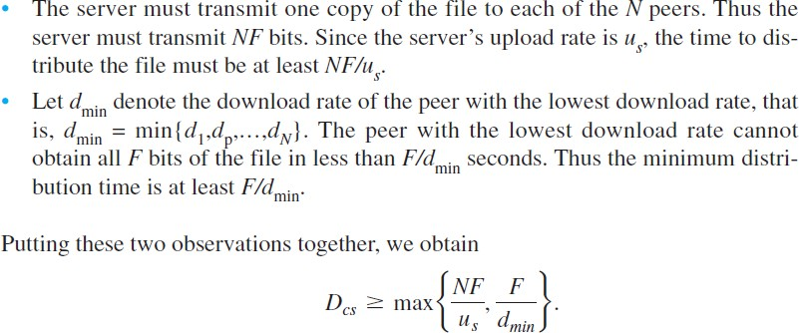
Distribution time for the client- server architecture
The distribution time is the time it takes to get a copy of the file to all N peers.
To determine the distribution time for the client-server
architecture- Dcs
An illustrative file distribution
problem
The distribution time increases linearly with the number of
peers N.
The server and the peers are connected to the Internet with access links. Denote the upload rate of the server’s access link by us, the upload rate of the ith peer’s access link by ui, and the download rate of the ith peer’s access link by di. Also denote the size of the file to be distributed (in bits) by F and the number of
peers that want to obtain a copy of the file by N.

Slide 7
File distribution time: client-server
server transmission: must sequentially send (upload) N file copies:
time to send one copy: F/u_{s}
time to send N copies: NF/u
s
client: each client must download file copy
d_{min} = min client download rate
min client download time: F/d_{min}
time to distribute F to N clients using client-server approach
D_{c-s} > max{NF/u_{s,},F/d_{min}}
increases linearly in N
Application Layer
2-28

Slide 8
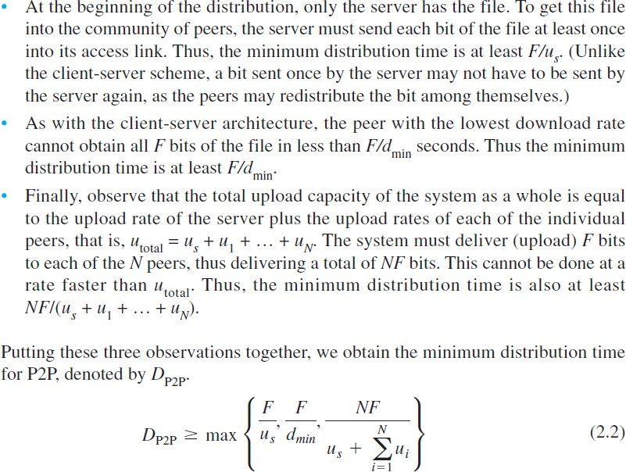

File distribution time: P2P
Scalability of P2P Architectures

Slide 9






File distribution time: P2P
server transmission: must upload at least one copy
time to send one copy: F/u_{s}
F
u_{s}
client: each client must download file copy
min client download time: F/d_{min}
d_{i}
network
u
i
clients: as aggregate must download NF bits
max upload rate (limiting max download rate) is u_{s} + Σu_{i}
time to distribute F to N clients using P2P approach
D_{P2P} > max{F/u_{s,},F/d_{min,},NF/(u_{s} + Σu_{i})}
increases linearly in N …
… but so does this, as each peer brings service capacity
Application Layer
2-30

Slide 10
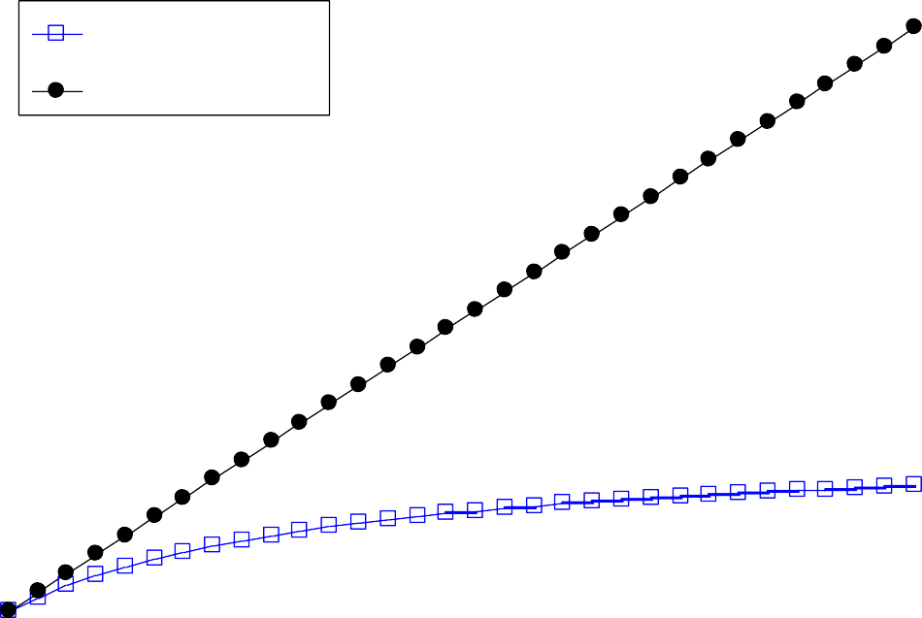
Client-server vs. P2P: example
client upload rate = u, F/u = 1 hour, u_{s} = 10u, d_{min} ≥ u_{s}
3.5
Minimum Distribution Time
P2P
3
Client-Server
2.5
2
1.5
1
0.5
0
0
5
10
15
20
25
30
35
N
Application Layer
2-31

Slide 11














P2P file distribution: BitTorrent
file divided into 256Kb chunks
peers in torrent send/receive file chunks
The collection of all peers participating in the distribution of a particular
file is called a torrent
tracker: tracks peers
participating in torrent: When a peer joins a torrent, it registers itself with the tracker and periodically
informs the tracker that it is still in the torrent
Once a peer has acquired the entire file, it may (selfishly) leave the torrent, or (altruistically) remain
in the torrent and continue to uploa
Alice arrives …
… obtains list
of peers from tracker
… and begins exchanging
file chunks with peers in torrent
chunks to other peers. Also, any peer
may leave the torrent at any time with only a subset of chunks, and later rejoin the torrent
2-32
Application Layer

Slide 12











P2P file distribution: BitTorrent
peer joining torrent:
has no chunks, but will accumulate them over time from other peers
registers with tracker to get list of peers, connects to subset of peers (“neighbors”)
while downloading, peer uploads chunks to other peers
peer may change peers with whom it exchanges chunks
churn: peers may come and go
once peer has entire file, it may (selfishly) leave or (altruistically) remain in torrent
Application Layer
2-33

Slide 13
BitTorrent: requesting, sending file chunks
requesting chunks:
at any given time, different peers have different subsets of file chunks
periodically, Alice asks each peer for list of chunks that they have
Alice requests missing chunks from peers, rarest first
sending chunks: tit-for-tat
Alice sends chunks to those four peers currently sending her chunks at highest rate
other peers are choked by Alice
(do not receive chunks from her)
re-evaluate top 4 every10 secs
every 30 secs: randomly select another peer, starts sending
chunks
“optimistically unchoke” this peer
newly chosen peer may join top 4
So at any given instant of time, Alice will have a subset of chunks and will know which chunks her neighbors have.
With this information, Alice will have two important decisions to make.
First, which chunks should she request first from her neighbors?
And second, to which of her neighbors should she send requested chunks?
Application Layer
2-34

Slide 14











BitTorrent: tit-for-tat
Alice “optimistically unchokes” Bob
Alice becomes one of Bob’s top-four providers; Bob reciprocates
Bob becomes one of Alice’s top-four providers
higher upload rate: find better
trading partners, get file faster !
Application Layer
2-35

Slide 15





